Slide 1
Group 2: Light My Desk
Student1468188: Pham Hoai Nhan
Student1468198: Le Ngoc Hai
Student1441819: Ngo Tan Phuc

Slide 2
Task Sheet Review 1
Project Ref.No1 |  | Project Title |  | Activity plan prepared by |  | Member |  | Status
Task
Acknowledgement | Light My Desk |  | Pham Hoai Nhan |  | Pham Hoai Nhan
Problem Statement | Light My Desk |  | Le Ngoc Hai |  | Le Ngoc Hai
Customer Specific Requirements | Light My Desk |  | Ngo Tan Phuc |  | Ngo Tan Phuc
Functional Requirements | Light My Desk |  | Pham Hoai Nhan |  | Pham Hoai Nhan
System Requirement Specification | Light My Desk |  | Le Ngoc Hai |  | Ngo Tan Phuc
Task Sheet Review 1 | Light My Desk |  | Le Ngoc Hai |  | Ngo Tan Phuc

Slide 3
Problem Statement 1.Introduction
The development of Information Technology and Internet help users access information, communication, transaction or shopping are so easily. With the rise of technology, Electronic Commerce has become a way to carry out the business transactions faster, more convenient, reduce cost for maintenance and employees.
With the price increasement of products with the technology development, we bring to the customer a competitive environment to get the product with lowest price.

Slide 4
2.Main Functions:
Users can order Study lamp after registering and logging in to the website. Study lamp will then be shipped to the customer's address (submit the order is done by email).
User can view all table lamp product as well as submit product reviews
Product admins manage the products and orders.

Slide 5
Customer’s Specific Requirement 1. Customer’s Specific Requirements
The website allows user register and login to become member, which can use all the function of the website like review product, pay for the order online or pay by cash on delivery.

Slide 6
2. Functional Requirements
There are 3 main actors:
Guest
User
Admin

Slide 7
1. Guests
1.1. Guests can view website information
1.1.1. Description
Guests can view the featured study lamp in homepage, study lamp by category.
1.1.2. Functional requirement
REQ-01: Guests can view study lamp information such as title, description, price.
REQ-02: Guests can view lists of study lamp is classified by category.

Slide 8
1.2. Guests can register an account
1.2.1. Description
Guests can register a website account
1.2.2. Functional requirement
REQ-01: Guests must provide information for the registration
• First name
• Last name
• E-mail

Slide 9
REQ-02: E-mail is unique. All fields are required and must follow format rule by system. REQ-03: The e-mail registered to create account must be verified by system by sending a verification code to the registered e-mail.
1.3. Guests can
1.3.1. Description
Guests can click on the study lamps to view detailed information.
1.3.2. Functional requirement
REQ-01: Guests can view study lamps information such as specification, price, return policies, product reviews.
1.4. Guests can search for study lamps
1.4.1. Description
Guests can search by study lamps name
1.4.2. Functional requirement
REQ-01: Show search results by name match

Slide 10
2. User
2.1. User can login with the registered account
2.1.1. Description
Visitor can login with the registered account with the following fields:
• E-mail
• Password
2.1.2. Functional requirement
REQ-01: User must login with the account previously registered to be able to order products.
2.2. User can log out of the site
2.2.1. Description
User can log out of the site if the account is logged in.
2.2.2. Functional requirement
REQ-01: User can log out of the site by clicking the link Logout.
2.3. User can edit profile
2.3.1. Description
User can edit first name, last name, dob, addresses, phone number.
User can change email but they need to verified email.
Email cannot change.
2.3.2. Functional requirement
REQ-01: User can edit first name, last name, dob, addresses, phone number.

Slide 11
2.4. User can recover password
2.4.1. Description
User can recover their password if they forget the password.
2.4.2. Functional requirement
REQ-01: The system will send password as a random string of characters to user's registered email. Then they need to login and change password.
2.5. User can review study lamps
2.5.1. Description
User can review after purchasing the study lamps.
2.5.2. Functional requirement
REQ-01: User can review product by rated stars (on 5) and comment.
REQ-02: Admin can edit product information.
REQ-03: Admin can delete the study lamps.
REQ-04: Admin can view all study lamps.
REQ-05: Admin can search for study lamps.

Slide 12
2.7. Admin can manage order
2.7.1. Description
Admin can manage all order.
2.7.2. Functional requirement
REQ-01: Admin can add new order.
REQ-02: Admin can edit order information.
REQ-03: Admin can delete the order.
REQ-04: Admin can view all orders.
REQ-05: Admin can search for orders.
2.8. Admin can manage user
2.8.1. Description
Admin can manage all users.
2.8.2. Functional requirement
REQ-01: Admin can add new users.
REQ-02: Admin can edit user information.
REQ-03: Admin can delete users.
REQ-04: Admin can view all users.
REQ-05: Admin can search for user.

Slide 13
3.System Requirement Specification:
1. Hardware
1.1. Web Server
Processor Core i3 5th or higher
Memory 2 GB RAM or higher
Modem Connecting Internet 24/24
1.2. Client
Processor Core i3 7th or higher
Memory 512 MB RAM or higher
Modem Connecting Internet

Slide 14
2. Software
2.1. Web Server
Operation
System Windows 7 or higher
Browser Chrome, Mozilla of Edge
Database MySQL
Software OpenJDK 11
2.2. Client
Operation
System Windows 7 or higher
Browser Chrome, Mozilla of Edge

Slide 15
Development Software
• Microsoft Windows 11
• Visual Studio Code
• MySQL
• Google Chrome
Technology
• Php
• Laravel 10
• Bootstrap 5
• Laravel MVC
• Laravel Security

Slide 16
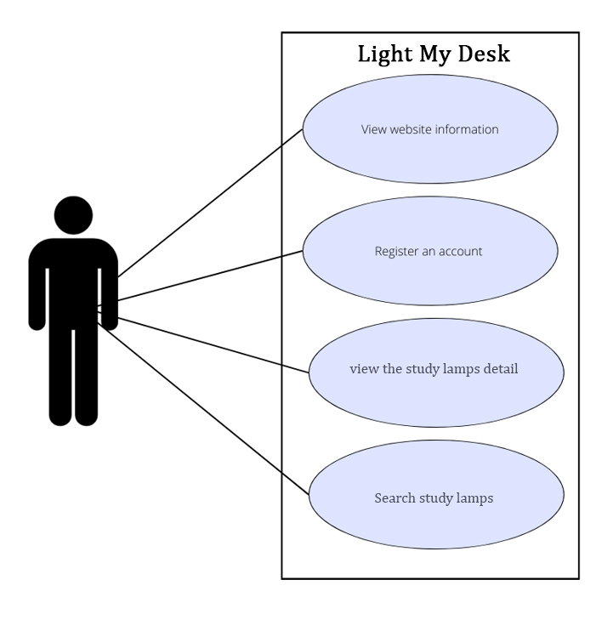
Review 2
Use Case Diagram
Visitor:

Slide 17
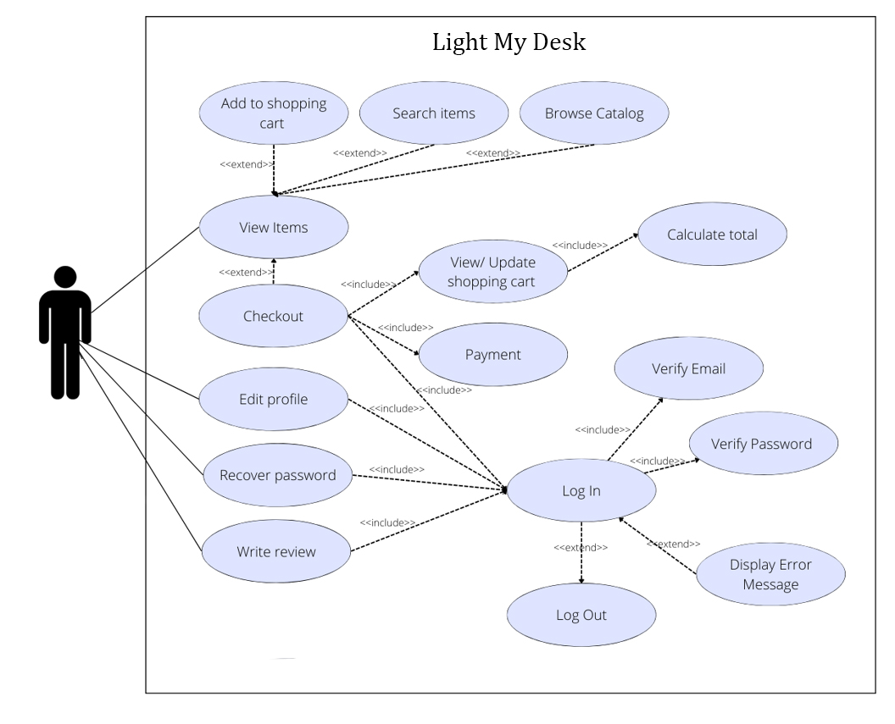
II. User:

Slide 18
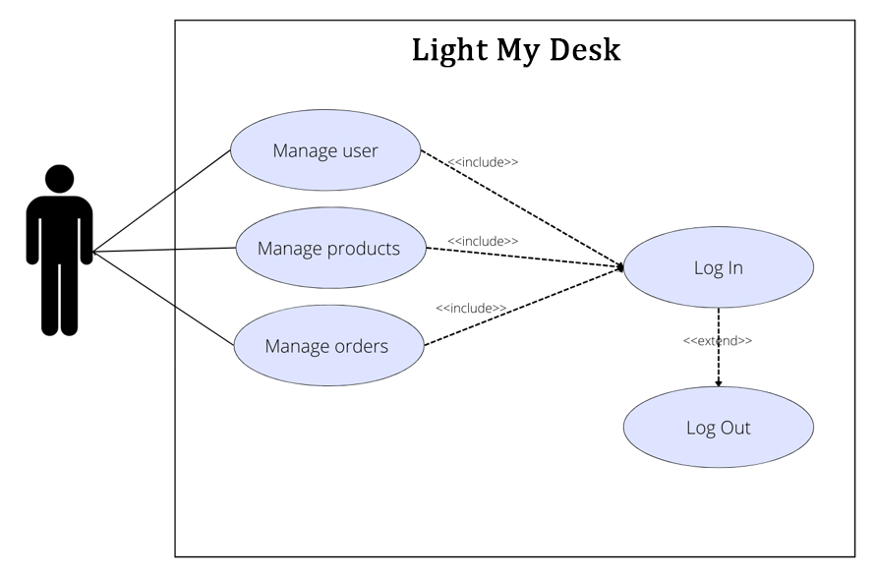
III. Admin:

Slide 19
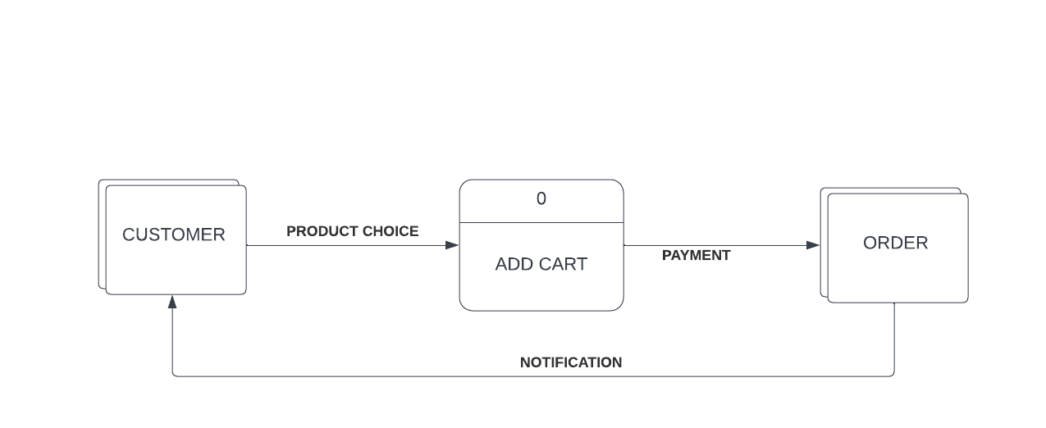
DFD
Diagram:

Slide 20
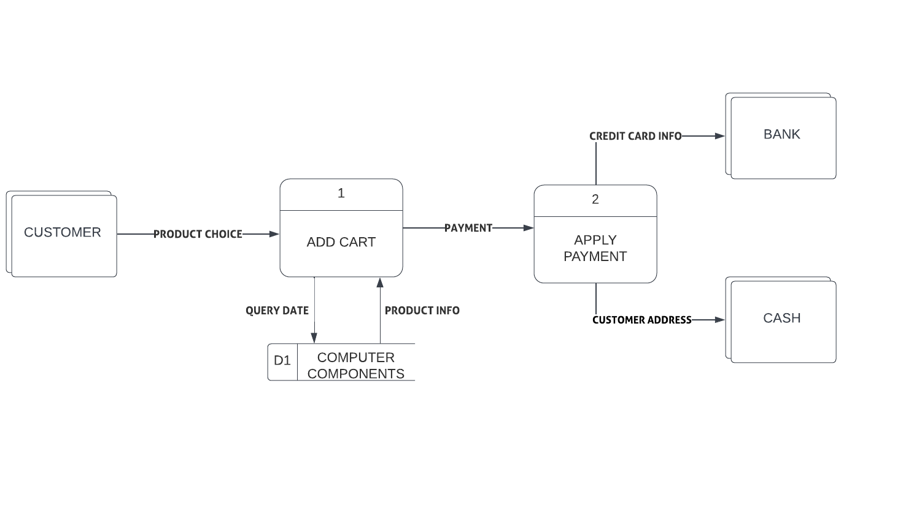
Diagram 1:

Slide 21
Thank you and have a nice day !

